Slide 1



Fighting Impostor Syndrome
A Practical Handbook
September 15th 2022
English Track - Auditorium
Notes:
I can see your future and it’s really great

Slide 2

Horoscope for the next 40 minutes
Notes:
At least for the next 40 minutes

Slide 3
Horoscope for the next 40 minutes
Let’s get acquainted!
A little bit of history
OK but… WHAT IS IT?
The practical bit (finally)
“Not a question, more of a comment”
Sources???

Slide 4
1. Let’s get acquainted!
I promise, that’s kinda relevant

Slide 5

Marine GANDY
DevRel Engineer at Platform.sh
that’s me

Slide 6

Marine GANDY
DevRel Engineer at Platform.sh
I mean,
THAT is me

Slide 7
My journey
I come from a literary background
I switched to web development at 25
I’m the current President of the French Drupal Association
I’ve been working remotely for 3 years
I love and do many things outside of work!

Slide 8
So why am I talking about this?

Slide 9
Because all these elements heavily influence
how I feel at work
Bear with me, it will make sense

Slide 10
2. A little bit of history
“Your past is just a lesson, not a life sentence.” - Deep Life Quote

Slide 11

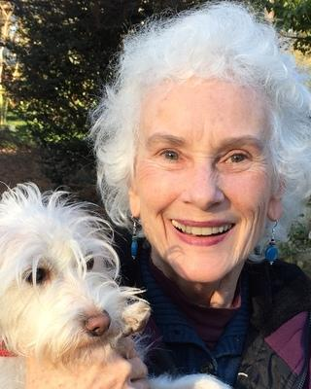
It all began in 1978
with two psychologists:
Dr Pauline Rose CLANCE
Dr Suzanne IMES

Slide 12
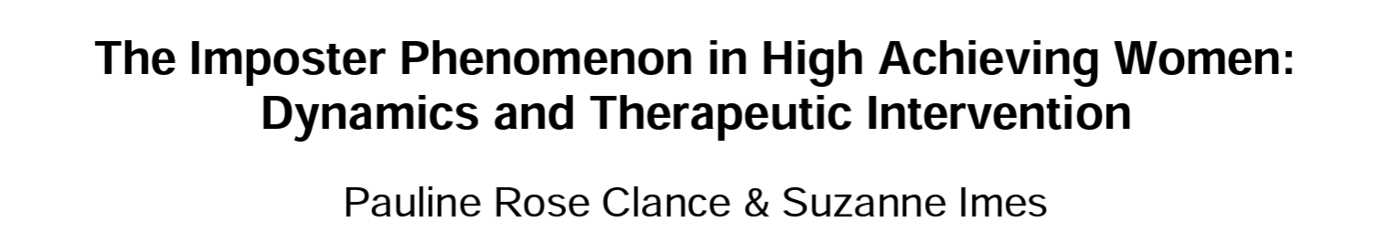
At first, they thought it only touched women…
But since then, more research has been conducted

Slide 13
It turns out…

Slide 14
The feeling is spread
equally
among men and women

Slide 15
Nowadays, we estimate that
70%
of people will experience this feeling

Slide 16
It’s not a disease,
it’s a common human experience !
This is why Dr Clance herself now uses the term
‘impostor phenomenon’
(and so should we)

Slide 17
Isn’t it more widespread in tech though?
The field of competence is very wide
⬇️
It’s impossible to master everything
⬇️
The tech and tools are evolving fast
⬇️
We’re constantly becoming ‘juniors’ again
I mean…
Yeah, some factors
don’t help ➡️

Slide 18
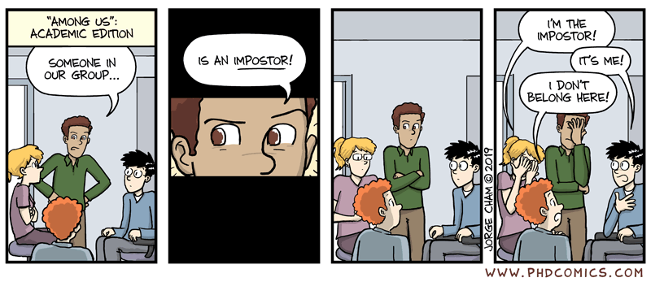

Slide 19
3. OK but… WHAT IS IT?
Oh you wanted an actual definition?

Slide 20
It’s kinda like
atychiphobia
Notes:
\a.ti.ki.fɔ.bia\

Slide 21
It’s kinda like
atychiphobia
Notes:
\a.ti.ki.fɔ.bia\

Slide 22
It’s kinda like
kakorraphiophobia
Notes:
Kakora fayo fobia https://www.youtube.com/watch?v=Zi7qDP17I64

Slide 23
OK FINE listen, it’s like
THE FEAR OF FAILURE

Slide 24
OK, we need Wikipedia.
“
Impostor syndrome [...] is a psychological occurrence in which an individual doubts their skills, talents, or accomplishments and has a persistent internalized fear of being exposed as a fraud.
Despite external evidence of their competence, those experiencing this phenomenon do not believe they deserve their success or luck.
[...] they may think that they are deceiving others because they feel as if they are not as intelligent as they outwardly portray themselves to be.
”

Slide 25
Have you ever heard of the fundamental attribution error?
It’s the tendency for people to
under-emphasize situational and environmental explanations
[...] while overemphasizing dispositional- and personality-based explanations.
(Thank you Wikipedia, again)

Slide 26

Screenshot: “L'effet Julien Lepers”, Horizon Gull

Slide 27
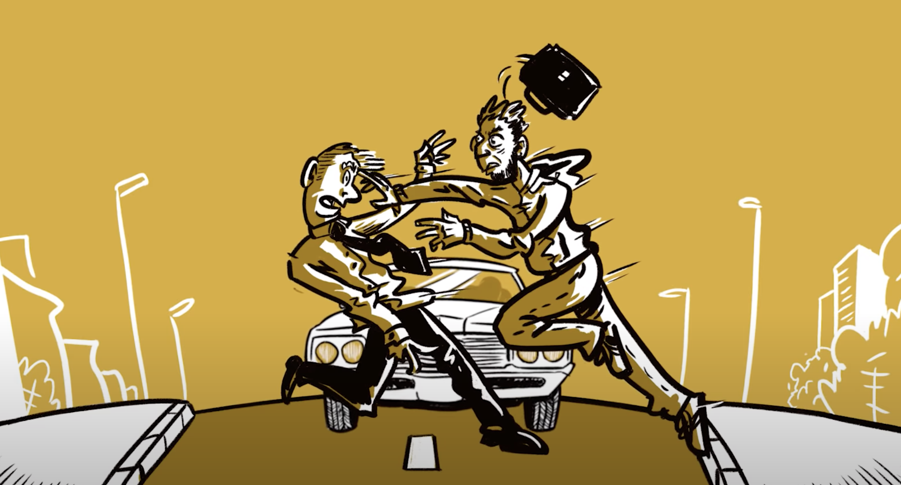
Screenshot: “L'effet Julien Lepers”, Horizon Gull

Slide 28
So the impostor phenomenon is pretty much the opposite!
Because you
overestimate external explanations
(aka: you’re just lucky)
while you underestimate internal explanations
(aka: you’re actually doing fine!)

Slide 29
Careful though!
Not everything is ‘impostor syndrome’!

Slide 30
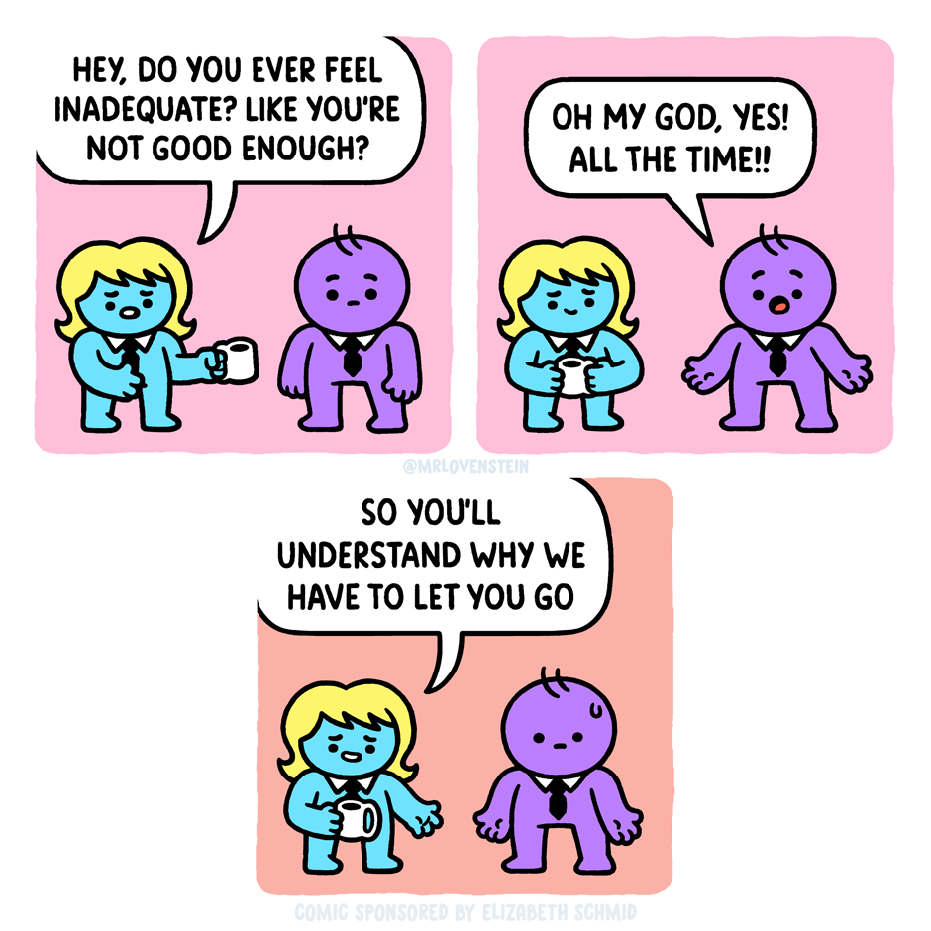
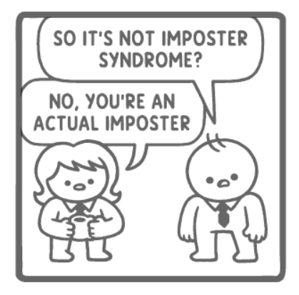
‘Assurance Fraud’ by Mr. Lovenstein
Notes:
https://tapas.io/episode/2640963

Slide 31
There’s a difference between the impostor phenomenon and…

Slide 32
a bad work environment
Notes:
A new mission / new responsibilities without training or resources:
Pressure, management denigrating you;
Coercion, demanding more and more work from you;
Harassment, toxic work environment;
=> the problem is not YOU and it’s not in your head!

Slide 33
It’s normal
to have doubts sometimes!
Starting over at a new company
Underrepresented groups
First job after school
Fancy new tech you don’t understand (yet)
Switching careers
Colleagues with 20+ years of experience
Notes:
Remember what I said earlier about my own experience? There it is. I’m a woman in a men-dominated field. When I started working on this, more than a year ago, I was working with very technical people and that was HARD.

Slide 34


Slide 35
OH NO
Here comes the part where you have to contribute

Slide 36

Notes:
If you’ve felt like an impostor clap your hands
If you’ve felt like an impostor clap your hands
If you’ve felt like an impostor
But somehow you’re still there
If you’ve felt like an impostor clap your hands
If you didn’t know the name clap your hands
If you didn’t know the name clap your hands
If you didn’t know the name
But you really felt the pain
If you didn’t know the name just clap your hands
If you want to hear the next part, clap your hands! OK then moving on!

Slide 37
4. The practical bit, finally
OK FINE, I’ll tell you!

Slide 38
Is it me, or is it the context around me?
Do I know what is expected of me?
Is communication fluid?
Is my job description clear?
Are my goals realistic and explicit?
Is the feeling recurrent?
Am I sensitive to a specific context (a new project, a new stack, a subject I don’t feel comfortable with?)
Is the feeling linked to someone in particular?
Do I get regular feedback?
Is the feedback always negative?
Do I always feel like I don’t deserve the praise I get, or do I enjoy some of my achievements?

Slide 39
Getting past the comparison and the competition
The Internet stars are not the only talented people!
Lots of anonymous devs are experts in their fields
By the way, being famous is not a proof of expertise…
There’s a reason we work in teams.
The differences in profile, experience and seniority enrich the team. Diversity is the key!
Accept that the others don’t know everything either

Slide 40
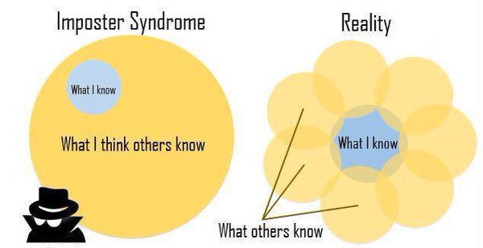
Getting past the comparison and the competition
Image taken from the article “Développeuses #2 : le syndrome de l’imposteur” by Aurélie Vache

Slide 41
Getting past the comparison and the competition
The Internet stars are not the only talented people!
Lots of anonymous devs are experts in their fields
By the way, being famous is not a proof of expertise…
There’s a reason we work in teams.
The differences in profile, experience and seniority enrich the team. Diversity is the key!
Accept that the others don’t know everything either
Take an interest in other people’s journey
How did they get here, what challenges did they overcome, what did they study, what was hard for them…
Get inspired! That might kickstart your own growth.

Slide 42
Working on your (perceived) weaknesses
Target
What is a cause of stress every single time?
What do I have to do often?
What is expected of me?
Prioritize
Choose one topic at a time and delve in it
Wandering means you will stay on the surface
Being recognized in your speciality is fulfilling!
Split!
Transform that mountain in small, manageable steps
Track your progress :)

Slide 43
Working on different skills
The aim: seeing your own progress
Go for dev-adjacent skills
Agility, communication, a new (human) language, web quality, accessibility, DevOps…
Bonus: it adds to your resume!
Or… go for something else entirely!
Pottery, gardening, knitting… doing something tangible for a change feels good
It’s a way to clear your mind, stop thinking about work
It’s not stressful: you’re doing something for yourself, there’s nothing at stake

Slide 44
Don’t stay alone!
Tell your team you need them!
Ask for regular feedback
Get help in order to reach your goals
Find your community
For me, it’s Duchess France, a women in tech network
Because it’s sometimes easier to be vulnerable with people outside your work team
Because you need people who have had similar experiences
Knowing that others enjoy working with you is the boost you need to see that you do belong!

Slide 45
Sharing is caring
Help others grow!
Support juniors / interns / new members
Offer pair programming sessions
Share the articles you read
Explain your job in schools, inspire new generations
Become a speaker, write articles
Choose a subject and deep-dive or present it with a different angle
You know you master your subject when you can explain it to others :)

Slide 46
Knowing that it has a name :)
YES you are normal!
You can ignore it and live with it, too

Slide 47
Getting (professional) help
Coaching, mentoring
Private classes, trainings, certifications
Mental health care

Slide 48
5. “Not a question,
more of a comment”
We don’t have time for questions anyway.

Slide 49

Thank you!
Marine GANDY (aka Mupsi)
DevRel Engineer, Platform.sh
marine.gandy@platform.sh
https://mupsi.dev
https://twitter.com/mupsigraphy
https://www.linkedin.com/in/marinegandy

Slide 50
6. Sources???
I promise I didn’t make it up!

Slide 51
The origins
Wikipedia article on impostor syndrome https://en.wikipedia.org/wiki/Impostor_syndrome
Compilation of research on the impostor phenomenon, Dr Pauline Rose Clance https://www.paulineroseclance.com/impostor_phenomenon.html
Clance Impostor Phenomenon Scale https://www.paulineroseclance.com/pdf/IPTestandscoring.pdf
‘The Imposter Phenomenon in High Achieving Women: Dynamics and Therapeutic Intervention’, Pauline Rose Clance & Suzanne Imes https://www.paulineroseclance.com/pdf/ip_high_achieving_women.pdf

Slide 52
Articles
‘Why Learning to Code is So Damn Hard’ https://www.thinkful.com/blog/why-learning-to-code-is-so-damn-hard/
‘Stop Telling Women They Have Imposter Syndrome’ https://hbr.org/2021/02/stop-telling-women-they-have-imposter-syndrome
‘The Dangers of Feeling Like a Fake’ https://hbr.org/2005/09/the-dangers-of-feeling-like-a-fake
‘Feel like a fraud?’ https://www.apa.org/gradpsych/2013/11/fraud
‘Feeling Like a Fraud: The Impostor Phenomenon in Science Writing’ https://www.theopennotebook.com/2016/11/15/feeling-like-a-fraud-the-impostor-phenomenon-in-science-writing/

Slide 53
Videos
‘What is imposter syndrome and how can you combat it?’, Elizabeth Cox https://www.youtube.com/watch?v=ZQUxL4Jm1Lo
‘How you can use impostor syndrome to your benefit’, Mike Cannon-Brookes (Atlassian) https://youtu.be/ZkwqZfvbdFw
‘6 Signs You Might Have Impostor Syndrome’, Psych2Go https://www.youtube.com/watch?v=xvGawC0eS4w
“L'effet Julien Lepers”, Horizon Gull (FR) https://www.youtube.com/watch?v=mrXtwcGkroI
“Pourquoi les américains nous paraissent-ils idiots ?”, Horizon Gull (FR) https://www.youtube.com/watch?v=Ic3xHn1E8EE

Slide 54
Random
‘“Among Us”: Academic edition’ by PhD Comics https://phdcomics.com/comics/archive.php?comicid=2042
‘Assurance Fraud’ by Mr. Lovenstein https://tapas.io/episode/2640963
Fundamental attribution error https://en.wikipedia.org/wiki/Fundamental_attribution_error
‘Batman: The Imposter’ trailer https://www.youtube.com/watch?v=O9L_70vpquQ
Dave Gahan’s ‘Imposter’ album https://www.youtube.com/playlist?list=PLK8pmrLAfsrgtiJxu9NmIXg-Jndm4iDvA

